Slide 1
Introduction to Web Programming

Slide 2
Outline
Client-Server concept
Server types
Http request types
Browser and mark up language
API and server side programming
Client side scripting vs server side scripting
XAMPP

Slide 3
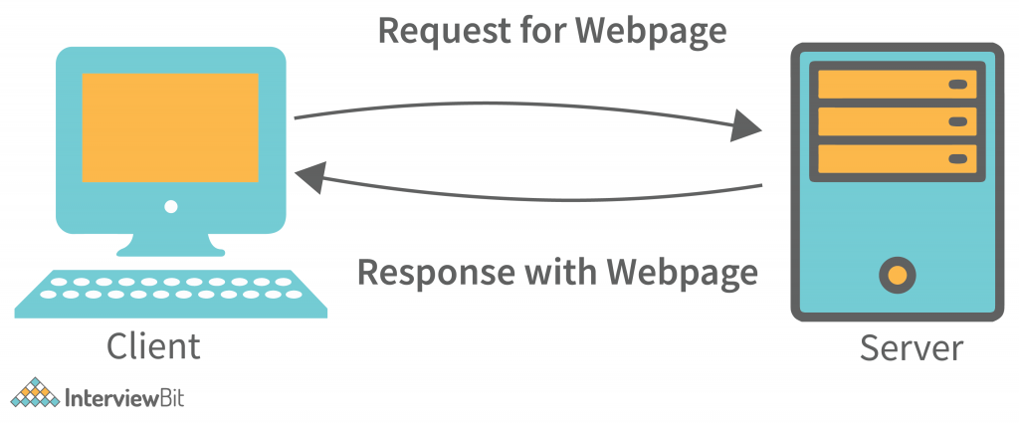
Client-Server concept
Reference:
Client Server Architecture - Detailed Explanation. (2022, June 3). InterviewBit. https://www.interviewbit.com/blog/client-server-architecture/

Slide 4
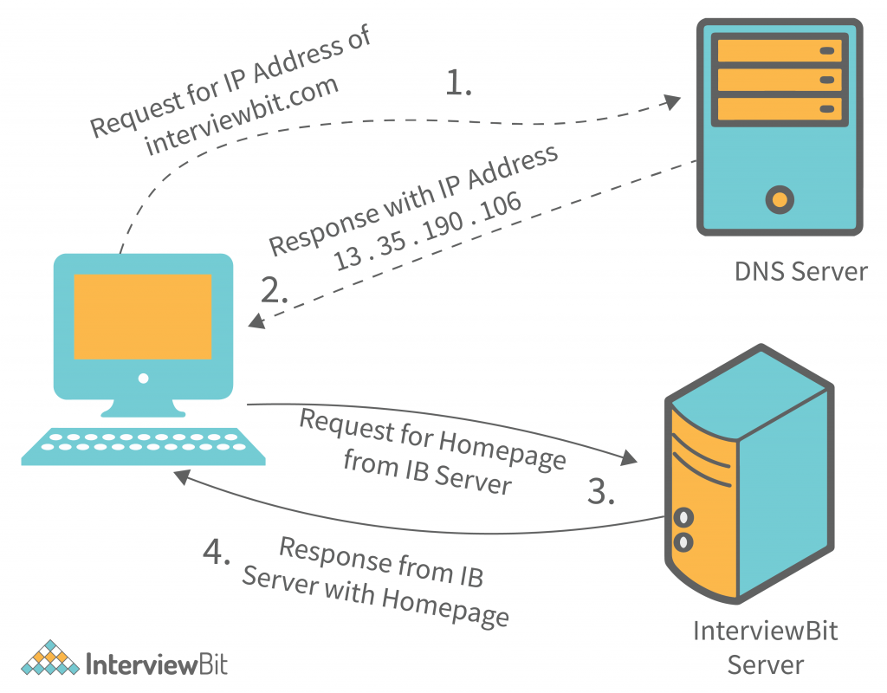
Client-Server concept

Slide 5
Server Types
Apache HTTP Server This is the most popular web server in the world developed by the Apache Software Foundation. Apache web server is an open source software and can be installed on almost all operating systems including Linux, Unix, Windows, FreeBSD, Mac OS X and more. About 60% of the web server machines run the Apache Web Server.
Internet Information Services The Internet Information Server (IIS) is a high performance Web Server from Microsoft.
Sun Java System Web Server The Sun Java System web server supports various languages, scripts and technologies required for Web 2.0 such as JSP, Java Servlets, PHP, Perl, Python, Ruby on Rails, ASP and Coldfusion etc.
Jigsaw Server Jigsaw (W3C's Server) comes from the World Wide Web Consortium. It is open source and free and can run on various platforms like Linux, Unix, Windows, Mac OS X Free BSD etc.

Slide 6
Remote Procedure Call in servers
Remote Procedure Call is a software communication protocol that one program can use to request a service from a program located in another computer on a network without having to understand the network's details
In hypertext transfer protocol (http), the remote procedure calls are known as REQUESTS.
The most common types of request methods are GET and POST but there are many others, including HEAD, PUT, DELETE, CONNECT, and OPTIONS.

Slide 7
Http Request Types
GET requests
Sent when URL is submitted in the browser location bar or a user clicks a link
Send data in the URL and query string
Reloadable
Can bookmark
Used for read-only operations
View, search, sort, or filter data
Data does not change

Slide 8
Http Request Types
POST requests
Sent when web form is submitted
Send data in the URL and as an attachment
Semi-reloadable (prompt to send data again)
Can not bookmark
Used for write operations
Create, update, or delete data
Data does change

Slide 9
Browser and Markup Language
Markup language is a text-encoding system consisting of a set of symbols inserted in a text document to control its structure, formatting, or the relationship between its parts.
Markup is often used to control the display of the document or to enrich its content to facilitating automated processing.
The HyperText Markup Language or HTML is the standard markup language for documents designed to be displayed in a web browser.
Web browsers receive HTML documents from a web server or from local storage and render the documents into multimedia web pages.

Slide 10
Browser and Markup Language
A browser’s job mainly consists of:
DNS resolution
HTTP exchange
Rendering

Slide 11
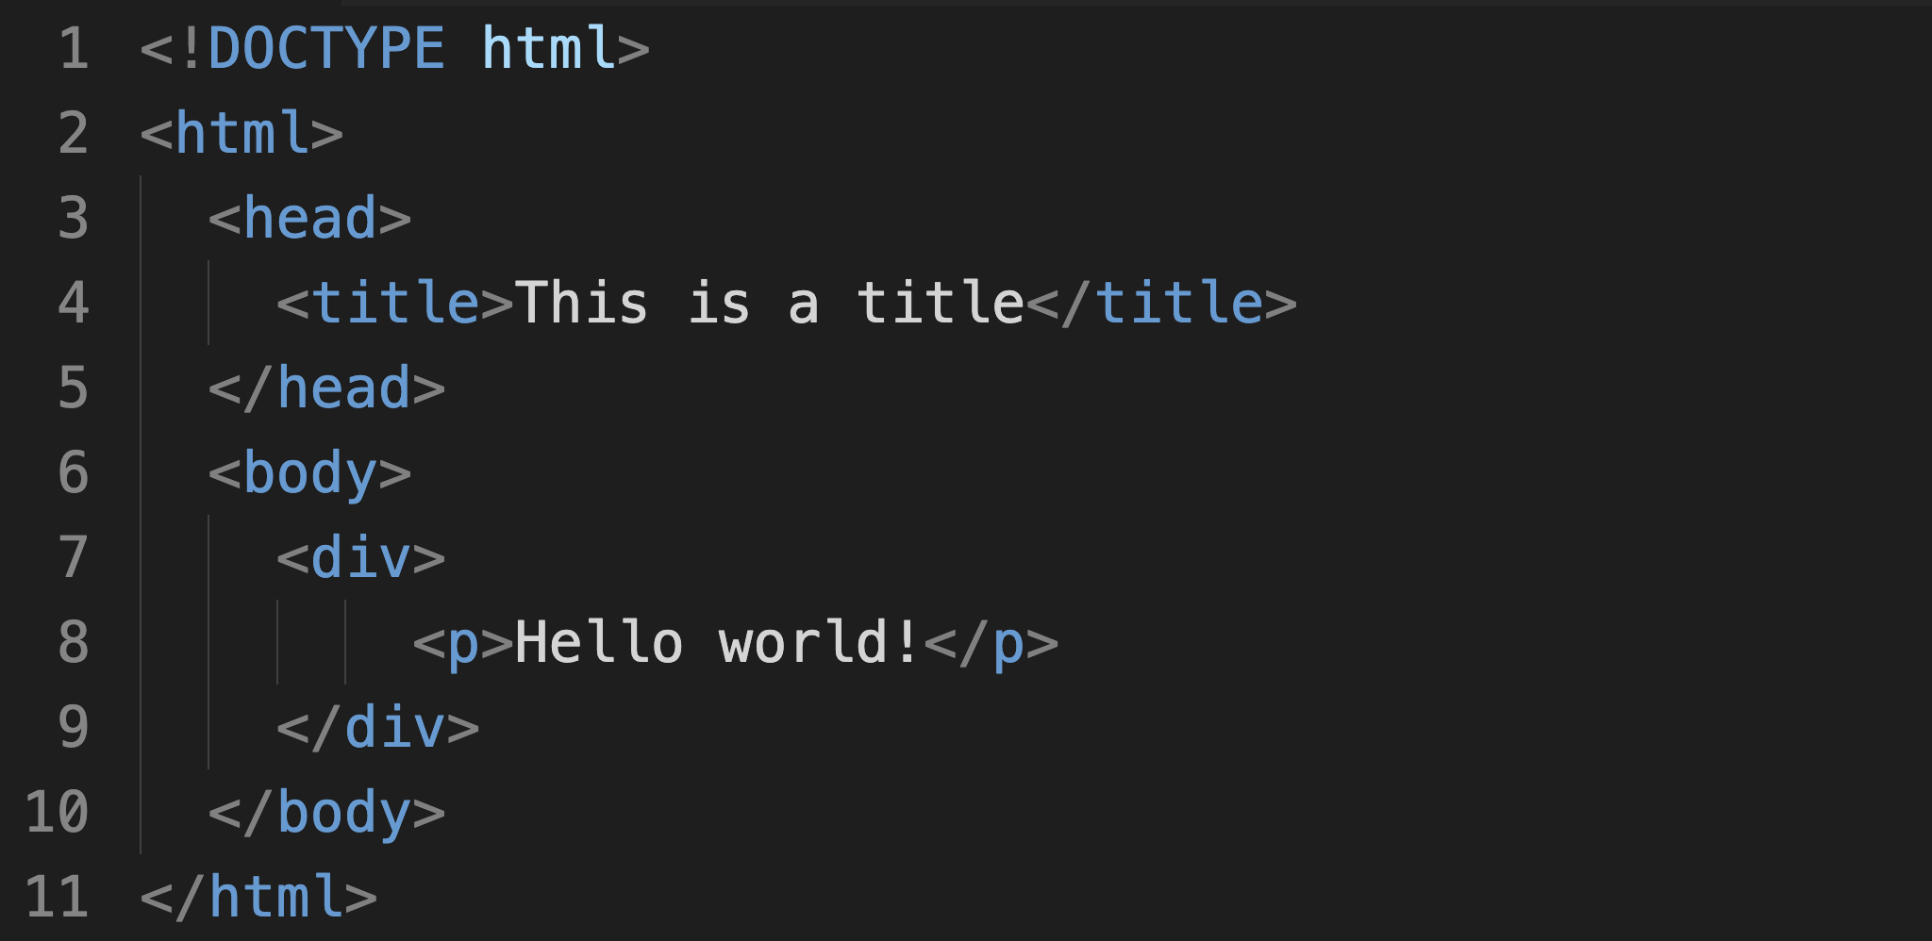
Browser and Markup Language

Slide 12
API and Server Side Programming
APIs are mechanisms that enable two software components to communicate with each other using a set of definitions and protocols.
API stands for Application Programming Interface.
API architecture is usually explained in terms of client and server. The application sending the request is called the client, and the application sending the response is called the server.

Slide 13
API and Server Side Programming
SOAP APIs These APIs use Simple Object Access Protocol. Client and server exchange messages using XML. This is a less flexible API that was more popular in the past.
RPC APIs These APIs are called Remote Procedure Calls. The client completes a function (or procedure) on the server, and the server sends the output back to the client.
Websocket APIs Websocket API is another modern web API development that uses JSON objects to pass data. A WebSocket API supports two-way communication between client apps and the server. The server can send callback messages to connected clients, making it more efficient than
REST API REST APIs These are the most popular and flexible APIs found on the web today. The client sends requests to the server as data. The server uses this client input to start internal functions and returns output data back to the client. Let’s look at REST APIs in more detail below.

Slide 14
Client-side scripting | Server-side scripting
Source code is visible to the user. | Source code is not visible to the user because its output of server-side side is an HTML page.
Its main function is to provide the requested output to the end user. | Its primary function is to manipulate and provide access to the respective database as per the request.
It usually depends on the browser and its version. | In this any server-side technology can be used and it does not depend on the client.
It runs on the user’s computer. | It runs on the webserver.
There are many advantages linked with this like faster. response times, a more interactive application. | The primary advantage is its ability to highly customize, response requirements, access rights based on user.
It does not provide security for data. | It provides more security for data.
It is a technique used in web development in which scripts run on the client’s browser. | It is a technique that uses scripts on the webserver to produce a response that is customized for each client’s request.
HTML, CSS, and javascript are used. | PHP, Python, Java, Ruby are used.
No need of interaction with the server. | It is all about interacting with the servers.
It reduces load on processing unit of the server. | It surge the processing load on the server.

Slide 15
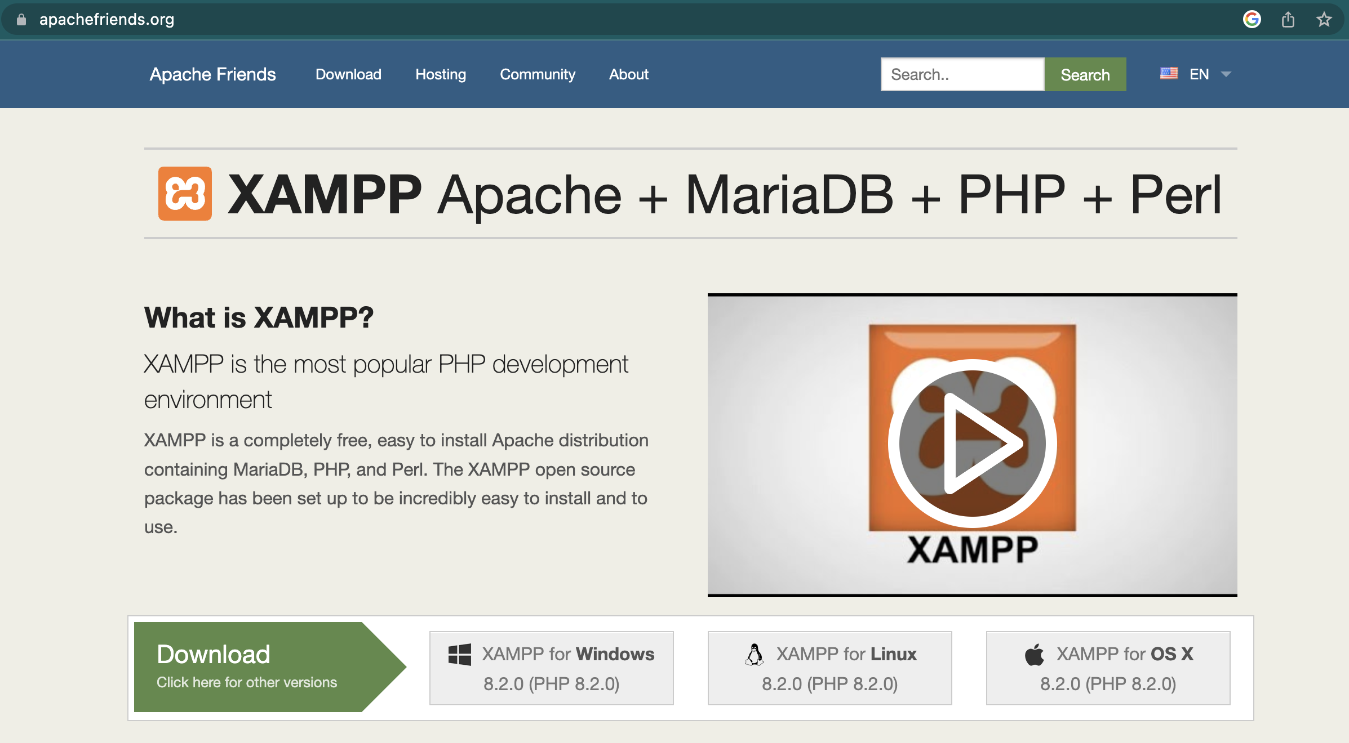
XAMPP

Slide 16
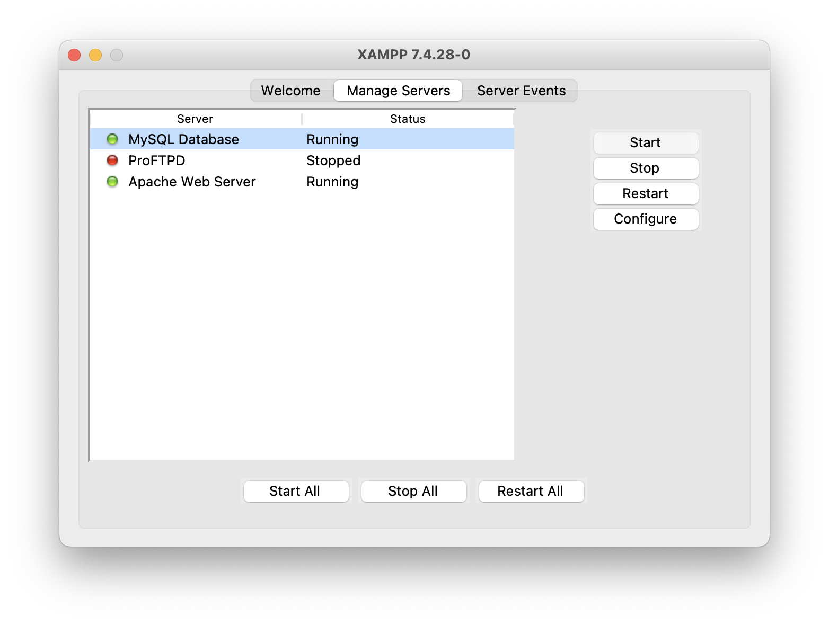
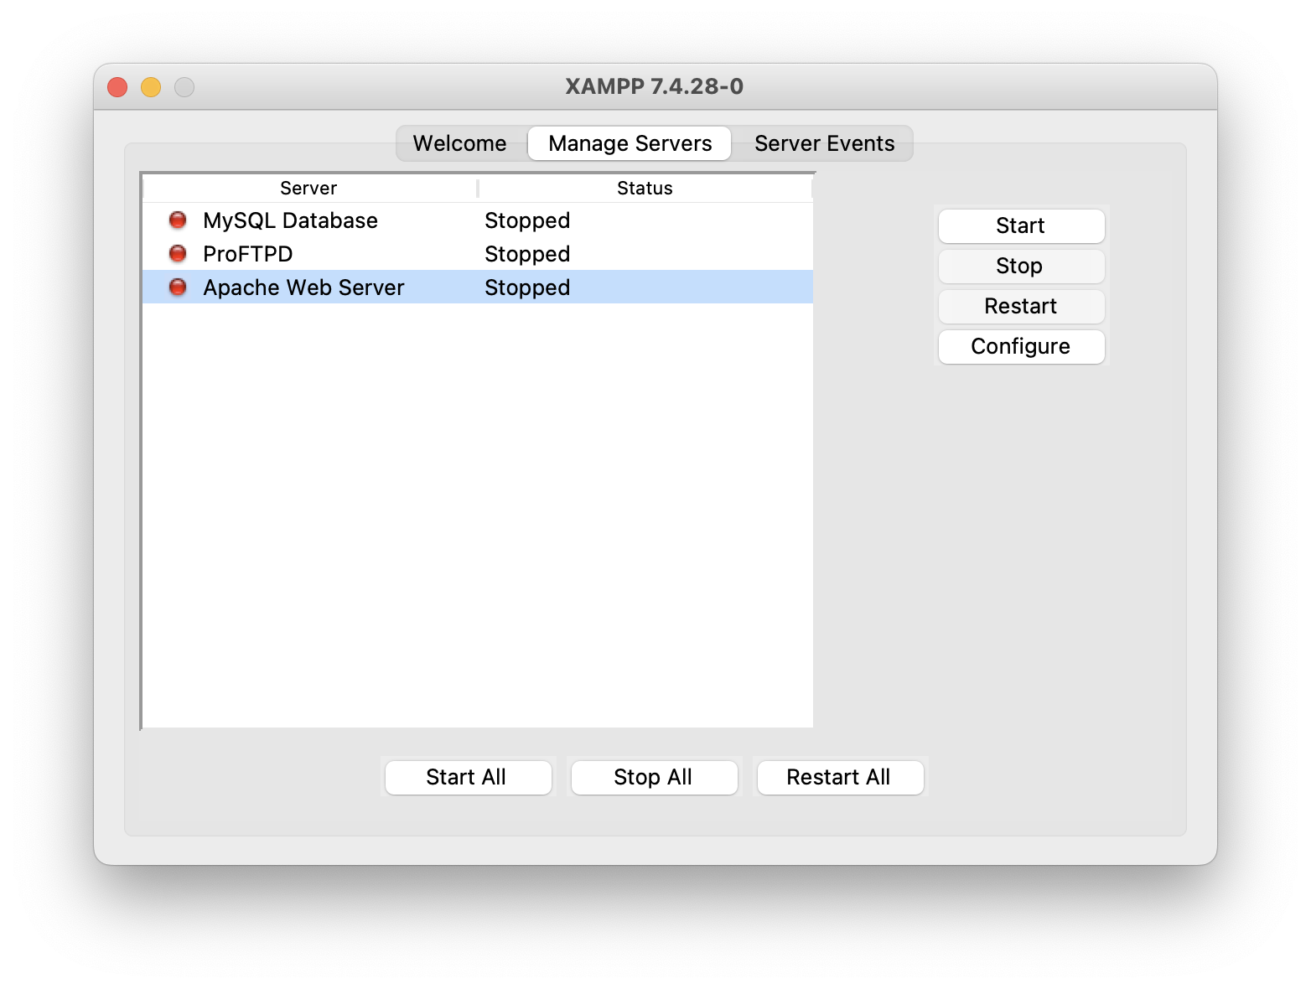
XAMPP

Slide 17
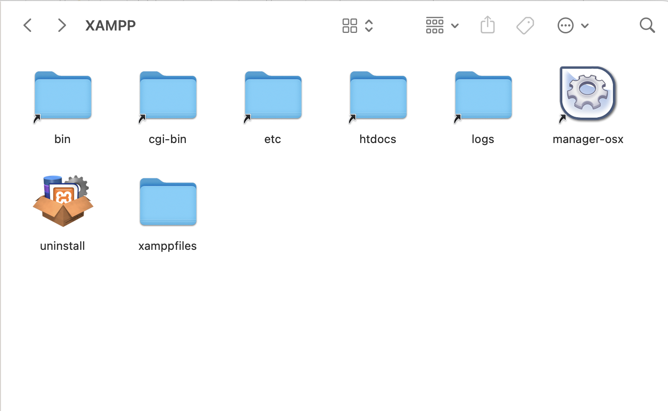
XAMPP

Slide 18
Thank You

